Slide 1
Applets
Appendix F
Sun Certified Java Programmer Workshop

Slide 2
Contents
Getting started with applets
Developing an applet
Deploying an applet
Parameterizing an applet
Using Swing in an applet
Demo project: DemoApplets

Slide 3
1. Getting Started with Applets
Overview of applets
How to write an applet
Applet UIs

Slide 4
Overview of Applets
What is an applet?
A special kind of Java program embedded in a Web page
Runs client-side within a browser
Managed and executed by a Java plug-in (built into the browser)
Purpose of applets:
Perform intelligent client-side processing via Java code
E.g. UI animations
E.g. complex algorithmic calculations

Slide 5
How to Write an Applet
An applet is a Java class
Must inherit from java.applet.Applet (AWT applets)
Or inherit from javax.swing.JApplet (Swing applets)
You can implement the following lifecycle methods:
void init()
Useful for one-time initialization (if needed) when applet is loaded
Put your initialization code here, rather than in a constructor
void start()
Called when applet is displayed – you should override this method
E.g. create a new thread to do time-consuming tasks, play animations, etc.
void stop()
Called when user navigates away from page – you should override this method
E.g. stop background threads
void destroy()
Useful for releasing resources (if needed)

Slide 6
Applet UIs
Applets can contain UI components
Text boxes, buttons, etc.
The Applet class inherits from java.awt.Panel
You can add AWT UI components directly to the applet
E.g. TextField, Button
The JApplet class inherits from Applet
Swing applets have a single root pane (just like a JFrame)
You can add Swing UI components to the root pane
E.g. JTextField, JButton

Slide 7
2. Developing an Applet
A “hello world” applet
Running an applet in Eclipse
Packaging an applet as a JAR

Slide 8
A Hello World Applet
Here’s a simple applet, to display applet lifecycle info
public class HelloWorldApplet extends Applet {
private StringBuffer buffer;
public void init() {
buffer = new StringBuffer();
addItem("init() ");
}
public void start() {
addItem("start() ");
}
public void stop() {
addItem("stop() ");
}
public void destroy() {
addItem("destroy() ");
}
…
}
private void addItem(String message) {
System.out.println(message);
buffer.append(message);
repaint();
}
public void paint(Graphics g) {
g.setColor(Color.RED);
g.drawRect(5, 5, getWidth() - 10, getHeight() - 10);
g.drawString(buffer.toString(), 10, 20);
}

Slide 9
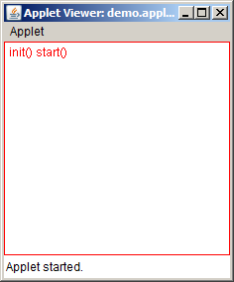
Running an Applet in Eclipse
You can run an applet within Eclipse
Run As | Java Applet
Launches appletviewer.exe (JDK tool for hosting an applet)

Slide 10
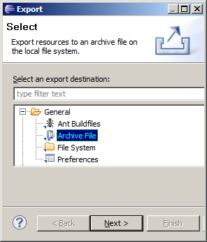
Packaging an Applet as a JAR
When you are ready to deploy your applet to the production Web server…
… it’s common practice to package the applet as a JAR file
To do this within Eclipse:
Right-click the Java file(s)
Select Export from pop-up menu
Select General | Archive File
Specify JAR filename / location
To do this from the command prompt:
cd bin (i.e. the build folder for your Java classes)
jar cvf MyApplet.jar .

Slide 11
3. Deploying an Applet
Using a simple <applet> tag
Using the Deployment Toolkit script
The Java Network Launch Protocol

Slide 12
Using a Simple <applet> Tag
Prior to Java SE 6 Update 10:
You deploy an applet by using an <applet> tag in an HTML page
The browser’s Java Plug-In automatically runs the latest version of the JRE installed on the client machine
Example:
Using <applet>:
Don’t have to use a JAR
Can specify codebase
<html>
…
<body>
<h1>Here's my HelloWorld applet</h1>
<applet archive='MyApplet.jar'
code='demo.applets.HelloWorldApplet.class'
width='300'
height='300'>
</applet>
p>Do you like it?</p>
</body>
</html> HelloWorldHostPage1.html

Slide 13
Using the Deployment Toolkit Script
For Java SE 6 Update 10 and above:
You should use the Deployment Toolkit JavaScript script
The script exposes a deployJava object, which has functions for downloading RIAs (i.e. applets and Java Web Start applications)
Example:
runApplet() arguments:
attributes
parameters
JRE min version (browser will download if necessary)
<html>
<script src="http://www.java.com/js/deployJava.js"></script>
…
<body>
<h1>Here's my HelloWorld applet</h1>
<script>
var attributes = { archive:'MyApplet.jar',
code:'demo.applets.HelloWorldApplet.class',
width:300, height:300 };
deployJava.runApplet(attributes, null, '1.6');
</script>
p>Do you like it?</p>
</body>
</html> HelloWorldHostPage2.html

Slide 14
The Java Network Launch Protocol
The deployJava object provides access to the Java Network Launch Protocol (JNLP)
Gives you very powerful control over how RIAs are deployed
For full details on JNLP, see:
http://download.oracle.com/javase/6/docs /technotes/guides/jweb /deployment_advice.html

Slide 15
4. Parameterizing an Applet
Overview
Defining parameters
Accessing parameters

Slide 16
Overview
You can define parameters for an applet
Define the parameters in the HTML page, as part of the <applet> tag or in the deployJava JavaScript object
Access the parameters in the applet code
Benefits:
Avoid hard-coding details in the applet code
Easier to modify in the HTML page

Slide 17
Defining Parameters
If you are using an <applet> tag:
If you are using the deployJava object:
<applet archive='MyApplet.jar'
code='demo.applets.ParameterizedHelloWorldApplet.class'
width='300'
height='300'>
<param name='greeting1' value='Bonjour' />
<param name='greeting2' value='mon ami' />
</applet> ParameterizedHelloWorldHostPage1.html
<script>
var attributes = { archive:'MyApplet.jar',
code:'demo.applets.ParameterizedHelloWorldApplet.class',
width:300, height:300 };
var parameters = { greeting1:'Hello', greeting2:'mate' }
deployJava.runApplet(attributes, parameters, '1.6');
</script> ParameterizedHelloWorldHostPage2.html

Slide 18
Accessing Parameters
To access parameters in an applet, call getParameter()
public class ParameterizedHelloWorldApplet extends Applet {
private StringBuffer buffer;
public void init() {
buffer = new StringBuffer();
String greeting1 = this.getParameter("greeting1");
String greeting2 = this.getParameter("greeting2");
addItem("init() says " + greeting1 + ", " + greeting2);
}
…
}

Slide 19
5. Using Swing in an Applet
Overview
Example Swing applet
Running the applet

Slide 20
Overview
You can use Swing components in an applet
Inherit from JApplet rather than Applet
JApplet has a content pane (just like JFrame)
You can assign a standard pane (e.g. JPanel) or a custom pane
You can add components to the pane, as normal
Note:
You should perform UI tasks in the event-dispatching thread
Ensures thread safety

Slide 21
Example Swing Applet (1 of 2)
Here's the outline for a simple Swing applet
public class SwingApplet extends JApplet implements ActionListener {
public void init() {
try {
SwingUtilities.invokeAndWait(new Runnable() {
public void run() {
createGUI();
}
});
} catch (Exception e) {
System.err.println("createGUI() exception occurred");
}
}
// See createGUI() method on next slide.
…
}

Slide 22
Example Swing Applet (2 of 2)
Here's the code to create the GUI, and to handle events
public class SwingApplet extends JApplet implements ActionListener {
…
private JLabel label = new JLabel("Enter text:");
private JTextField textField = new JTextField(20);
private JButton button = new JButton("Click me");
private void createGUI() {
JPanel pane = new JPanel();
pane.setBorder(BorderFactory.createEmptyBorder(20, 20, 20, 20));
pane.add(label);
pane.add(textField);
pane.add(button);
button.addActionListener(this);
this.setContentPane(pane);
}
public void actionPerformed(ActionEvent evt) {
JOptionPane.showMessageDialog(this,
textField.getText(),
"My Dialog Box",
JOptionPane.PLAIN_MESSAGE);
}
}

Slide 23
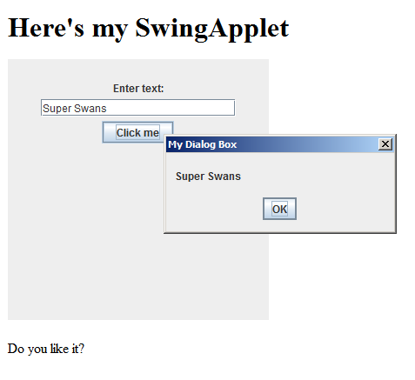
Running the Applet
This is how the applet appears when you run it
Also see the SwingAppletHostPage.html host page

Slide 24
Summary
Getting started with applets
Developing an applet
Deploying an applet
Parameterizing an applet
Using Swing in an applet

